Slide 1
10 steps to DevOps Part 9: Continuous Configuration / Package Management
James Tramel
Developer Strategist
james.tramel@microsoft.com
Notes:
a

Slide 2
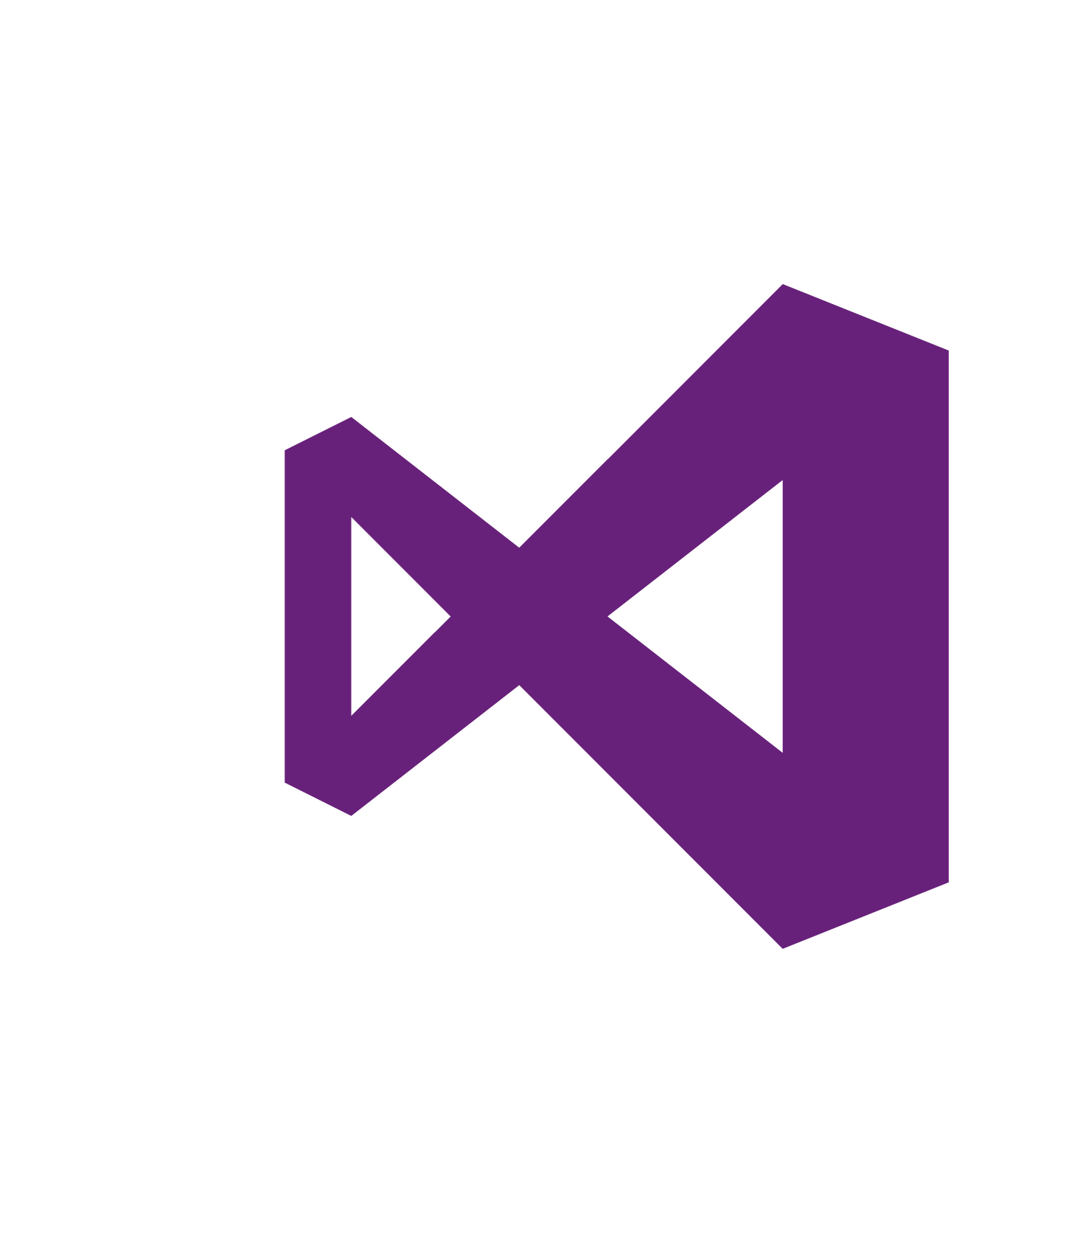
Every app Every Developer Every Platform
Visual Studio Online
Visual Studio
.NET
Notes:
The tool for everything. .net, sharepoint – web forms.
Mobile development - pokemon
Web Developer – notepad – web extensions
Javascript – typescript angular.
Talking Points
With the increase and diversity of devices there is an opportunity for developers to reach users where they are.
Also with the power of the cloud, infrastructure and capital expenditures no longer have to be a barrier to creating great applications.
Visual Studio 2015 bridges mobile and the cloud by being the first version built to target mobile-first and cloud-first development.

Slide 3
Software delivery challenges
?
Frustration
Delays
Lack of insights

Slide 4
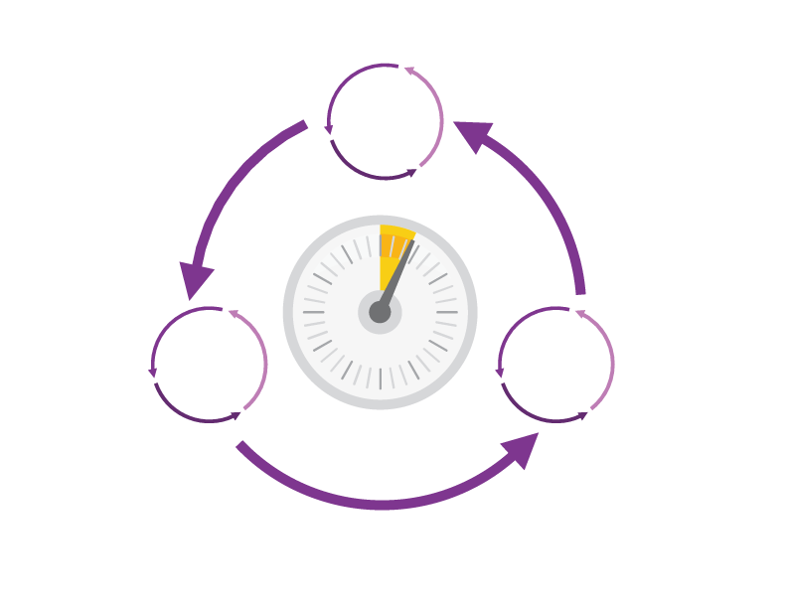
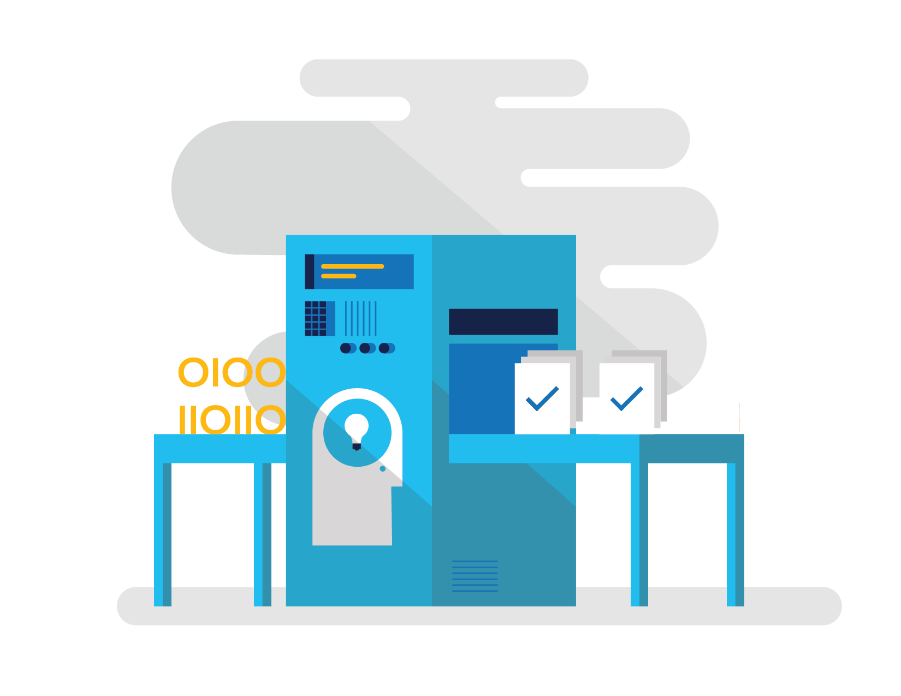
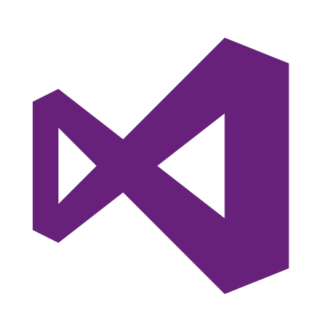
How Microsoft can help
Shorten Cycle Times
Optimize Resources
Improve Quality and Availablilty
Speed up and increase traceability of each release by empowering your development and operations teams with advanced collaboration and automation tools.
Efficiently manage environments using technologies that support self-service provisioning in a secure way, in line with your IT governance standards.
Capture rich telemetry on application performance and usage so that you can make better decisions on future investments and anticipate issues in production before they impact your service.
Visual Studio Team Services
Microsoft Azure
Visual Studio
Notes:
The Microsoft DevOps Solution provides a comprehensive set of software, cloud services, and other essential resources that help you deliver higher-quality software faster with less risk.
This solution is focused on addressing the most pressing challenges of the modern application lifecycle:
Shortening cycle times through advanced release management and automation tools
Optimizing resources and eliminating waste, and
Increasing quality and availability of your solutions

Slide 5






DevOps: the three components
DEV
OPS
1
People
2
Process
3
Products
Notes:
DevOps is the union of people, process, and products to enable continuous delivery of value to our end users.”\\
Focus today, from me, is process and products. Will focus on the how. The people is you. Be the change you want to see.

Slide 6
DevOps
1
4
Plan
Monitor + Learn
Development
Production
2
3
Develop + Test
Release

Slide 7
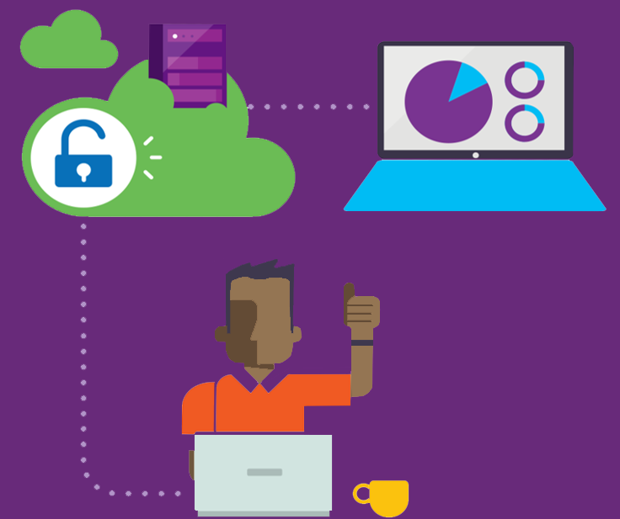
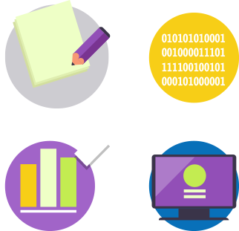


Visual Studio Enterprise – the tool for DevOps
Optimized for enterprise-class development
An integrated, end-to-end solution for teams of any size with demanding quality and scale needs. Take advantage of comprehensive tools and services for designing, building and managing complex enterprise solutions.
Greater productivity for enterprise application development and delivery
Plan, execute and monitor your entire quality effort, continuously
Manage complexity and close
the loop between Dev and Ops
Notes:
The tool for everything. .net, sharepoint – web forms.
Web Developer – notepad – web extensions
Javascript – typescript angular.

Slide 8
DevOps habits and practices
BACKLOG refined with LEARNING
MANAGED TECHNICAL DEBT
PRODUCTION FIRST MINDSET
INFRA-STRUCTURE is a FLEXIBLE RESOURCE
TEAM AUTONOMY & ENTERPRISE ALIGNMENT
EVIDENCE gathered in PRODUCTION
FLOW OF CUSTOMER VALUE

Slide 9
DevOps habits and practices
LEARN
Application Performance Management
Infrastructure as Code
Continuous Deployment
Release Management
Configuration Management
Automated Recovery
PLAN
Source Control
Stakeholder Feedback
Kanban
Bug Tracking
TEST
Application Performance Management
Usage Monitoring
Telemetry Collection Testing in Production
Stakeholder Feedback
APPROVE
Feature flags
Code Reviews
Automated Testing
Continuous Measurement
BACKLOG refined with LEARNING
MANAGED TECHNICAL DEBT
PRODUCTION FIRST MINDSET
INFRA-STRUCTURE is a FLEXIBLE RESOURCE
TEAM AUTONOMY & ENTERPRISE ALIGNMENT
EVIDENCE gathered in PRODUCTION
FLOW OF CUSTOMER VALUE
APP
Automated Testing
Code Review
Technical Debt
Continuous Integration
Continuous Deployment
Release Management
iNFRA
Automated Enviornment De Provision
Self Service Enviornment
Auotmated Recovery
MONITOR
Infrastructure as Code
Continuous Delivery
Release Management
Configuration Management
Automated Recovery
Testing in Production
Usage Monitoring
User Telemetry
Notes:
Automated Testing
Continuous Integration
Continuous Deployment
Release Management
Usage Monitoring
Telemetry Collection
Testing in Production
Application Performance Management
Infrastructure as Code
Continuous Delivery
Release Management
Change / Configuration Management
Automated Recovery
Load Testing
Avaialability Monitoring
Capactiy Management
Automated Enviornment De Provision
Self Service Enviornment
Auotmated Recovery (roll back / roll forward)
Stakeholder Feedback
Feature flags
Code Reviews / Technical Debt

Slide 10
Dev Ops Skill Katas
Modern Debugging
Automated Unit Testing and Architectural mapping
Work item / bug tracking / Continuous Test
Continuous deployment / integration
Infrastructure as code
Integrated testing / technical debt management
Release management
Dev / test environments
Continuous configuration / package management
Monitor and analyze
Notes:
Social club – intellitrace – works on anything .net
Taxation – intellitest and code maps
Sonar qube – vstsdemo – my shuttle 2 – myshuttle ci
https://sonarqube.com/, click rules
Package manager – parts unlimited – build – surreal engine – show feeds
Continuous integration – click on triggersin a build
Continuous deployment – parts unlimited
http://partsunlimited.azurewebsites.net/
Show deployment slots
Azurejut – dupont welcome -
Release – show Aramark azurejt
IAC – show github repo
Show create a new resource
https://github.com/Azure/azure-quickstart-templates
Dev test labs – en portal
Monitor and analytiz – so java portal or farkacam on my portal

Slide 11

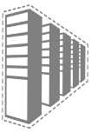
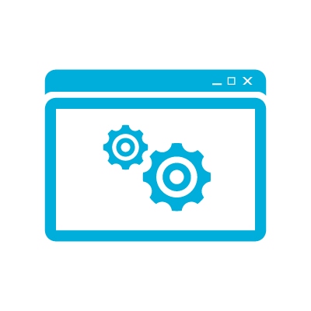
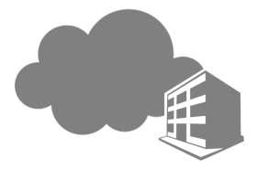

Cloud consistency
Deploy, customize, and manage across clouds
I can develop, configure, and deploy across my entire infrastructure
Integrated with Release Manger for continuous deployment support.
Change configuration through DSC.
Supports template deployment for consistency across on-premises and public clouds.
Traditional
Virtualized
Private cloud
Public cloud
Notes:
[Slide goal]
N/A
[Talk track]
N/A

Slide 12
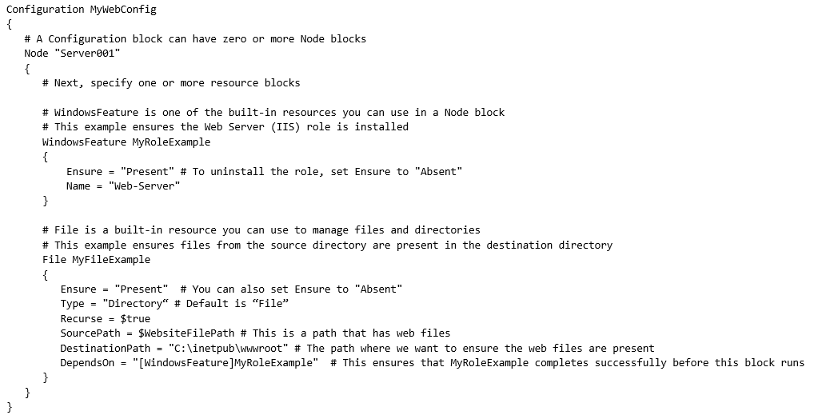
Desired state configuration
Configuration templates
Build templates to manage your configuration.
Integrate them with Release Management to automate configuration of on-premises and public cloud environments.
Notes:
[Slide goal]
Outline the capabilities of DSC
[Talk track]
Desired state configuration is a management platform in Windows PowerShell that enables deploying and managing configuration data for software services and managing the environment in which these services run.
Desired state configuration provides a set of Windows PowerShell language extensions, Windows PowerShell cmdlets, and resources that you can use to declaratively specify how you want your software environment to be configured. It also provides a means to maintain and manage existing configurations.
Practical applications:
Following are some example scenarios where you can use built-in desired state configuration resources to configure and manage a set of computers (also known as target nodes) in an automated way:
Enabling or disabling server roles and features.
Managing registry settings.
Managing files and directories.
Starting, stopping, and managing processes and services.
Managing groups and user accounts.
Deploying new software.
Managing environment variables.
Running Windows PowerShell scripts.
Fixing a configuration that has drifted away from the desired state.
Discovering the actual configuration state on a given node.
In addition, you can create custom resources to configure the state of any application or system setting.

Slide 13
Manage the full stack
Telemetry
Application Insights
Monitor/Learn
Diagnostics
Application Insights
Performance
Application Insights
Notify Approvers
Release Management
Approve
Notify Approvers
Release Management
Manual Tests
Microsoft Test Manager
Test
Automated Tests
Coded UI, Web, Load
Create Test Data
BacPac with SSDT
Configure Application
Tokenization
App
Install Application
NuGet, WebDeploy, etc
Configure Environment
Desired State Configuration
Infra
Provision Environment
Azure Resource Manager
Tracking Work
TFS / VSTS
Plan
Planning Work
TFS / VSTS
Notes:
Infrastructure as Code (IaC)
Continuous Integration
Automated Testing
Continuous Deployment
Release Management
App Performance Monitoring
Load Testing & Auto-Scale
Availability Monitoring
Capacity Management
Change/Configuration Management
Feature Flags
Automated Environment De-Provisioning
Self Service Environments
Automated Recovery (Rollback & Roll-Forward)
Hypothesis Driven Development
Testing in Production
Fault Injection
Usage Monitoring / User Telemetry

